Slide 1
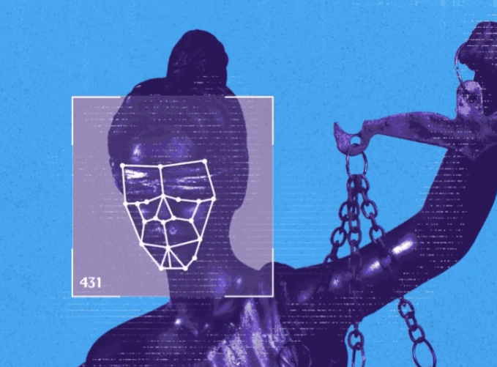
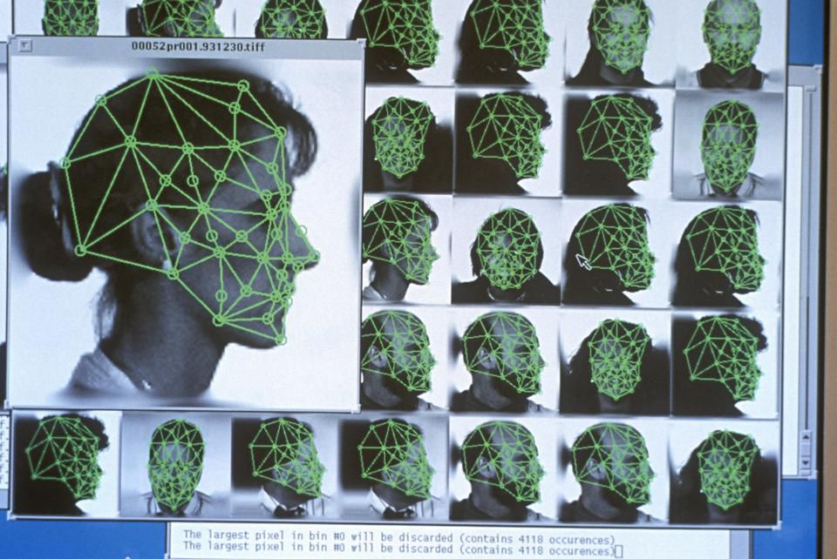
Facial Recognition
The facial recognition software analyzes your face. And identifies keys features.
A picture of your face is captured by a photo or video
The software sends back an output to the user. This output could be that your face matches or doesn’t match
The key features and the scanned face are then compared to a database of faces. It looks through this database trying to find a matching face

